Slide 1


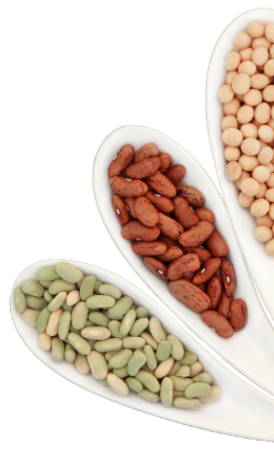
10-Year Pulse Research Strategy
IYP Global Dialogue
FAO, Rome
22-23 Nov 2016
Shoba Sivasankar
Director
CGIAR Research Program on Grain Legumes
Notes:
This report presents an internationally coordinated strategy designed to increase investment in strategic pulse research. The 10-Year Research Strategy report will be used to set an agenda for global discussion and mobilize champions to advocate for accelerated pulse research investments.

Slide 2
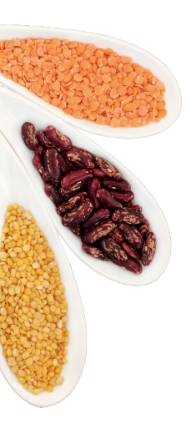
The 10-Year Pulse Research Strategy: Background and Process
Why a 10-Year Pulse Research Strategy?
  Unmet potential of pulses to contribute to the UN SDGs
  Persisting challenges to production and consumption
  Low research investment relative to major crops
Development of the strategy:
  Sept 2016: Interviews with 33 experts for first draft
  Oct 2016: 17-member write shop
  Nov 2016: Draft to 175 pulse stakeholders for comments
  Current: Verification meeting
  Nov 29: Inputs from meeting into current draft
  Dec 2: Final report

Slide 3
5 Chapters or Research Areas
Breeding and genetics for improved productivity and resilience
Pulses in integrated cropping systems and agricultural landscapes
Integration of pulses into food systems
Integration across agricultural, nutritional and social sciences
Spatially-explicit analyses related to global challenges
Research Objectives;
Tools and Approaches;
Capacities and Competencies

Slide 4
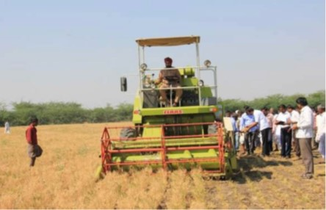
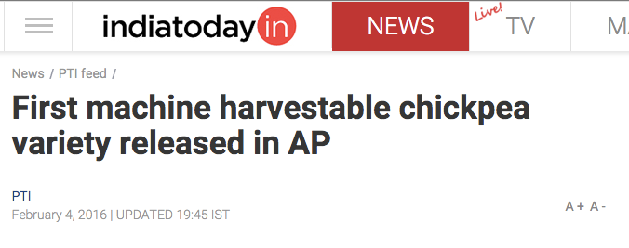
Chapter 1: Breeding and Genetics for Improved Productivity and Resilience
Optimising yield, resilience and other production objectives
    Yield stability
    Biological nitrogen fixation
    Water and nutrient use efficiency…
Optimising end uses
    Content, quality, availability of nutrients
    Alignment with consumer preferences…
Exploiting synergies
Courtesy: Pooran Gaur, ICRISAT

Slide 5
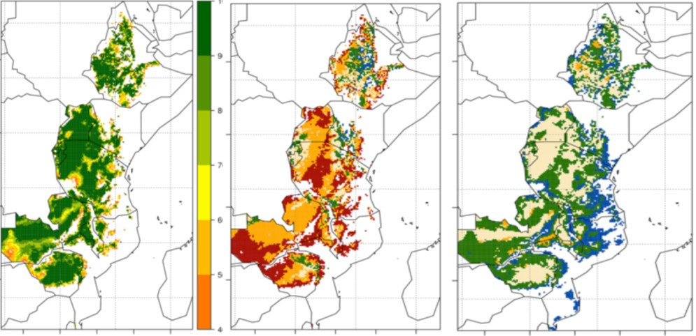
Development of Heat-Tolerant Beans
Current adaptation
Adaptation in 2050 with no research
Adaptation in 2050 with +3ºC additional heat tolerance
Courtesy: Steve Beebe, CIAT

Slide 6
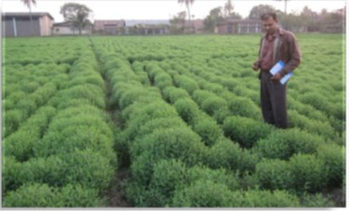
Chapter 2. Pulses in Integrated Cropping Systems and Agricultural Landscapes
Optimising production methods
    Rotations, intercropping, relay cropping
    Integrated pest management
    Nutrient management…
Quantifying impacts of pulses in farming systems
    Nitrogen budgets
    Greenhouse gas footprints
    Agrobiodiversity and ecosystem services…
Facilitating adoption by farmers
    Access to information, inputs, tools
    Analysis of demand and constraints…
Production technologies for lentil
Courtesy: Shiv Agrawal, ICARDA

Slide 7
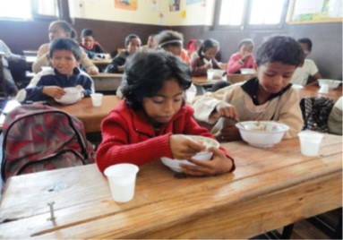
Chapter 3. Integration of Pulses into Food Systems
Understanding contexts and drivers
Understanding value-chain actors
Implications for women and youth
Implications for diet and health
Value addition
Sustainability and safety
National School Feeding Programme of Madagascar, using bean-based flour

Slide 8
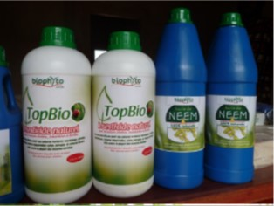
Chapter 4. Integration across agricultural, nutritional and social sciences
Strengthening multi-disciplinary research
    Coordinated planning and application of diverse expertise
Cross-species collaboration with cereal-crop researchers
    Production technologies for cereal-based cropping systems
Understanding policy context and enabling policy dialogues
    Economically viable to farmers
Locally-made biopesticides for effectiveness and income
Courtesy: Manu Tamo, IITA

Slide 9
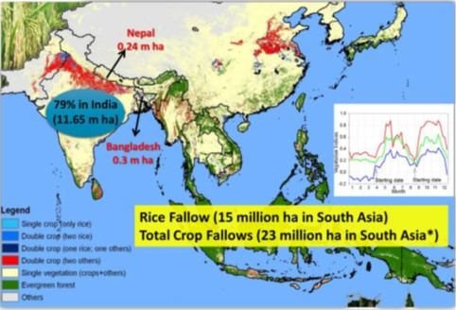
Chapter 5. Spatially-Explicit Analyses Related to Global Challenges
Contribution to global and national challenges
    Quantification of benefits against targets
    Strategic targeting of investments
Opportunities and risks in specific geographies
    Crop simulation and modeling
    Climate change and foresight planning
Success factors
    Targeting of interventions for success
Mapping of rice fallows and total crop fallows, South Asia

Slide 10
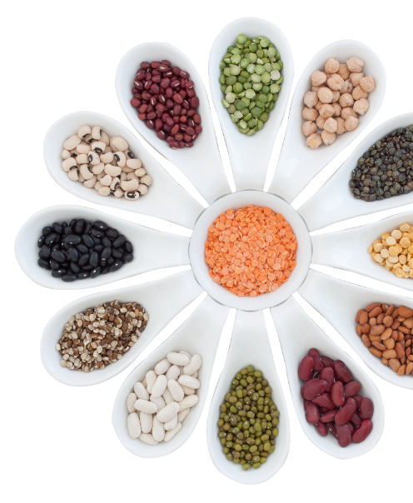


THANK YOU!
Notes:
Robynne

